Slide 1
FoodVerse
Presented
By
Diya Raina(2210990304)
Khushi Jamloki(2210990513)
Divanshu Kaushik(2210990290)
Under the supervision of
Mr. Vikas Patel
Ms. Parul Gahelot
Chitkara Institute of Engineering & Technology
Chitkara University, Punjab

Slide 2
Problem Statement
In today's fast-paced lifestyle, many individuals struggle to find the time and resources to cook nutritious meals at home. They face challenges such as limited access to diverse recipes, lack of ingredient transparency, inefficient recipe organization, and time constraints. These barriers hinder their ability to maintain a healthy diet and enjoy the benefits of home cooking. In light of these challenges, there is a pressing need for a solution that addresses the barriers to home cooking and empowers individuals to lead healthier lives through nutritious and enjoyable meals prepared at home.

Slide 3
Solution
Foodverse simplifies your cooking journey by offering a comprehensive collection of recipes from around the world, ensuring you'll always find something delicious to try.
Explore a diverse range of recipes with ease, whether you're in the mood for comforting classics, international specialties, or healthy alternatives.
Access detailed ingredient lists for every recipe, including precise measurements and nutritional information, empowering you to make informed choices and plan your meals effectively.
Enjoy a hassle-free cooking experience with Foodverse's user-friendly interface and intuitive features, making every step of the cooking process—from finding recipes to preparing ingredients—a breeze.

Slide 4
Motivation of Research
Convenience: We aim to provide a convenient solution for discovering, accessing, and saving recipes, streamlining the cooking process for busy individuals.
Variety and Exploration: With Foodverse, we encourage culinary exploration by offering a diverse range of recipes from different cuisines and dietary preferences, catering to various tastes and preferences.
Ingredient Transparency: Transparency is key to making informed dietary choices. Foodverse provides detailed ingredient lists and nutritional information for every recipe, empowering users to cook healthier meals.
Personalization: Foodverse offers a personalized cooking experience, making it easy to revisit and recreate beloved dishes.

Slide 5



Tools & Technologies
React: Drives dynamic user interfaces with efficient component management.
JavaScript: Adds real-time interactions and content updates for enhanced user experience.
HTML: Provides structural foundation for accessible and searchable content presentation.
CSS: Styles and designs interfaces for consistency and visual appeal
Responsive Design: Ensures optimal viewing across devices for seamless user experience.
Netlify: For deploying our website.

Slide 6
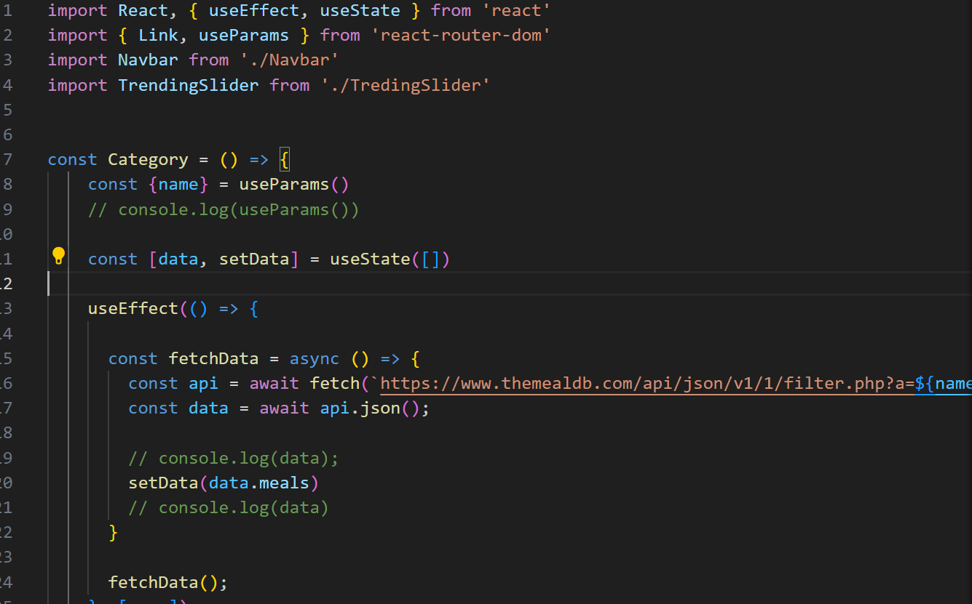
Code Snapshots
Category.jsx:

Slide 7

Code Snapshots
App.css:-

Slide 8
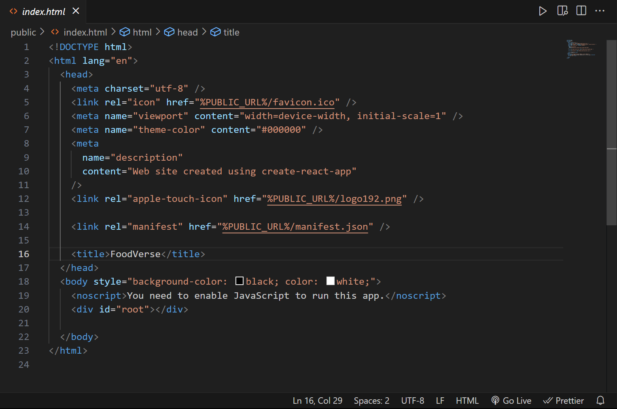
Code Snapshots
Index.html:-

Slide 9
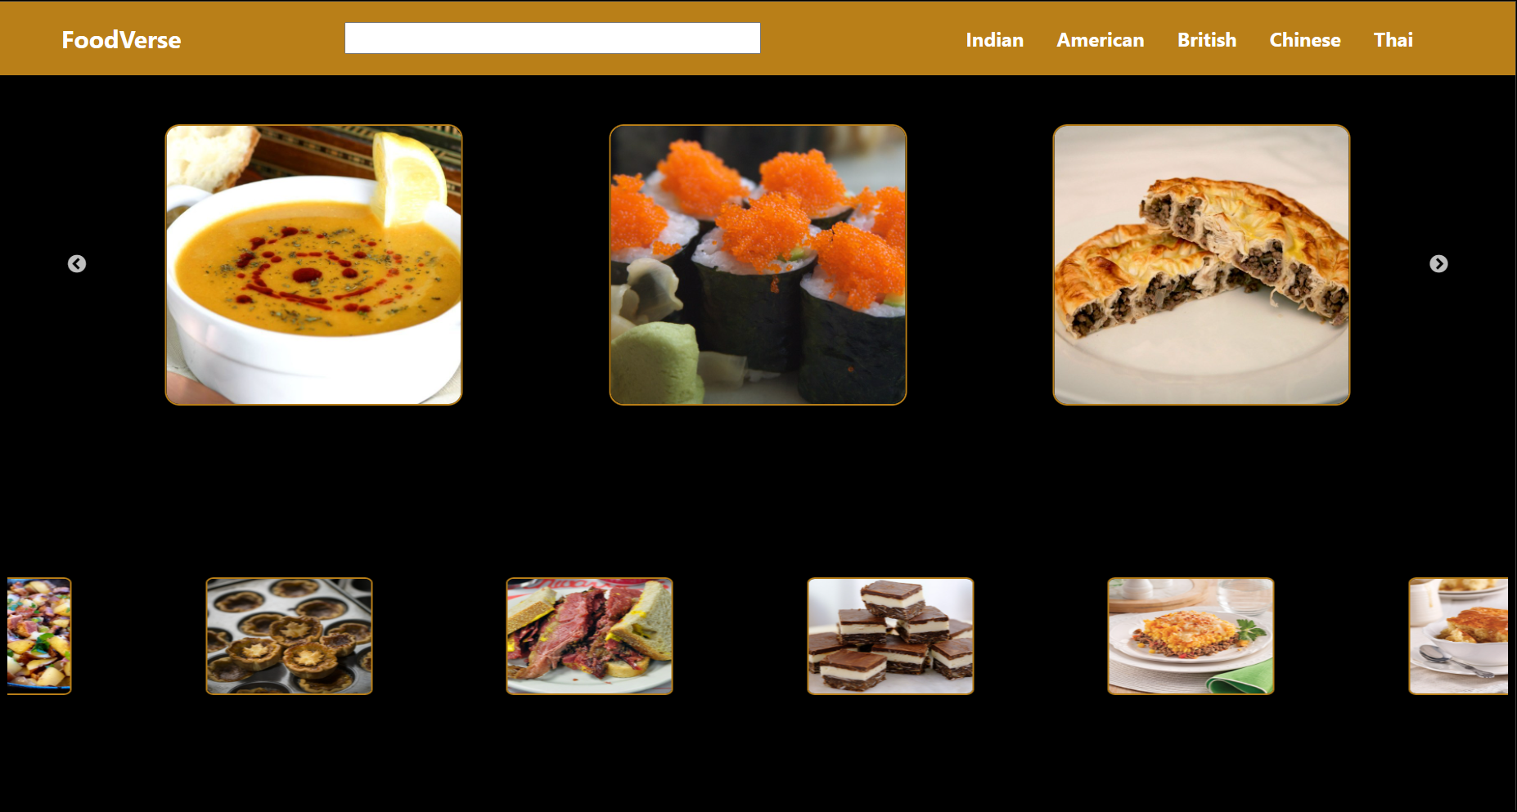
Home Page

Slide 10
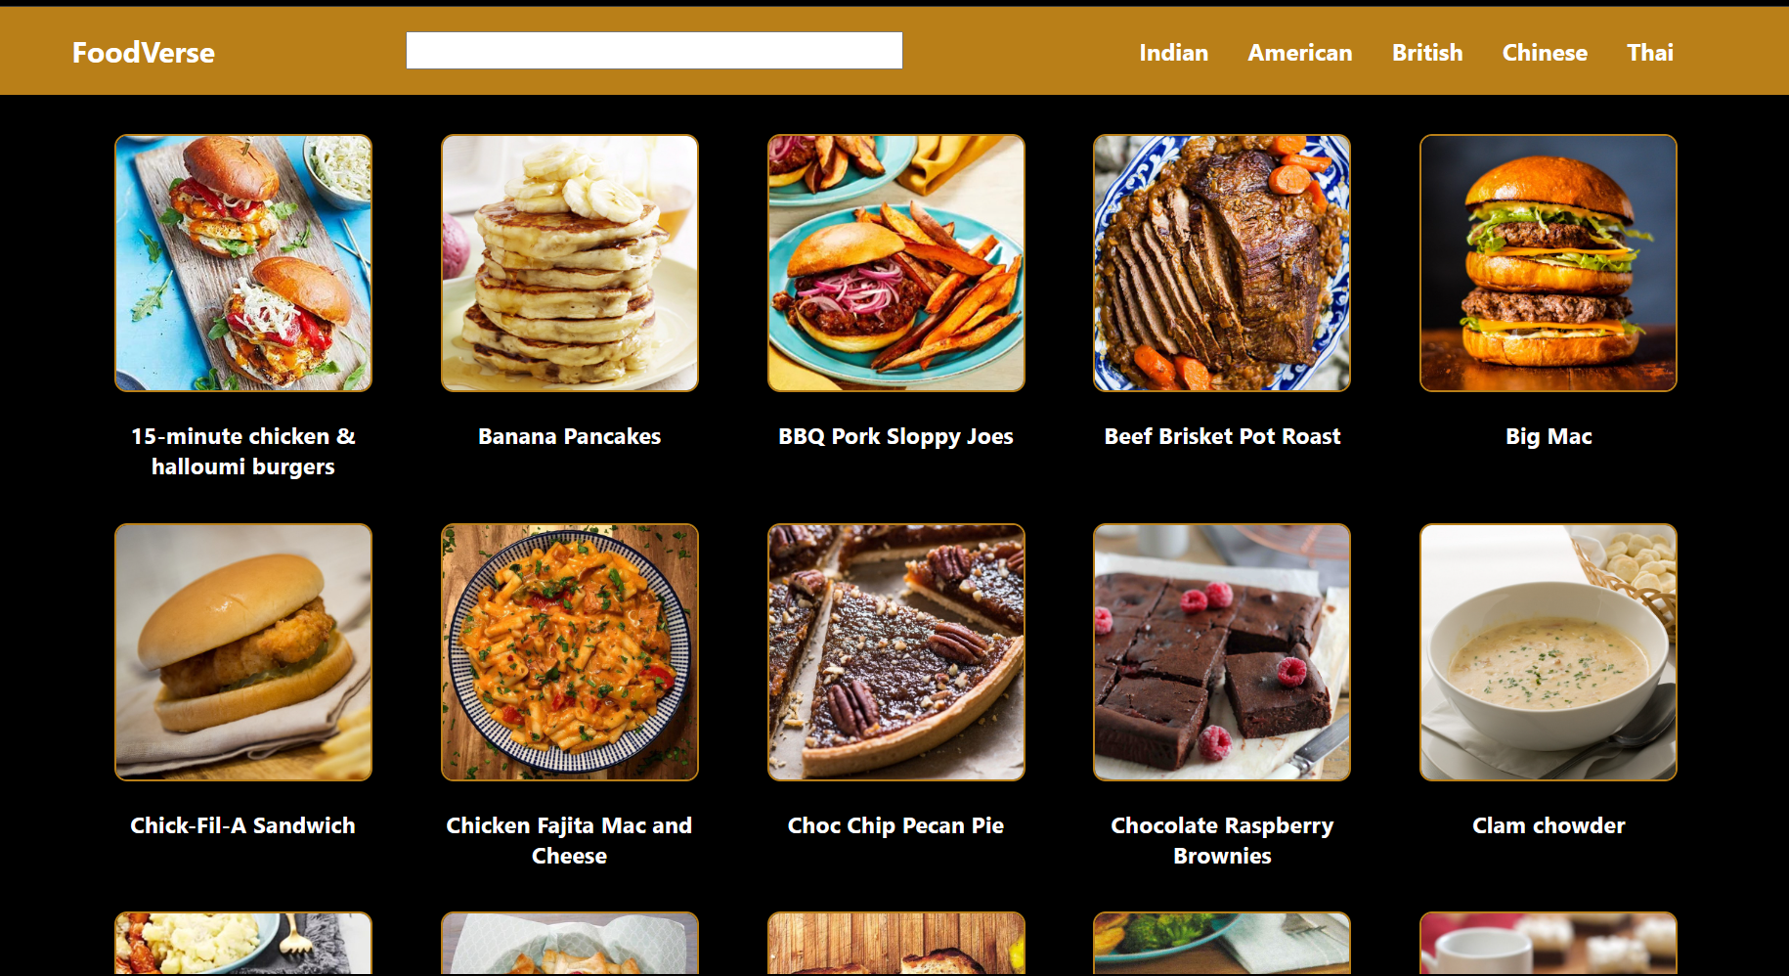
Snapshot

Slide 11
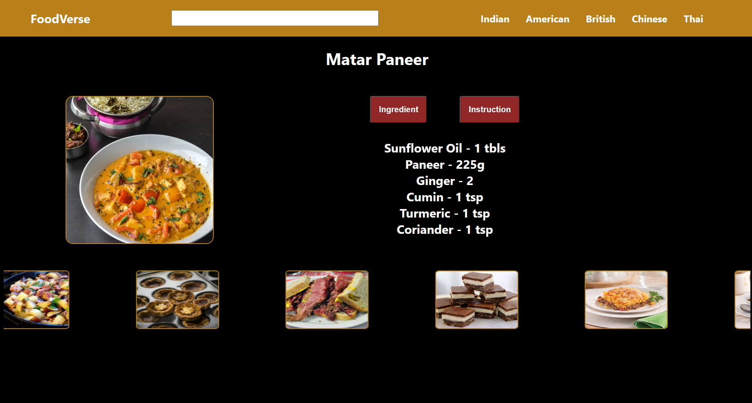
Snapshot

Slide 12
Conclusion
Our React project addresses common challenges encountered when cooking healthy meals at home.
We've simplified the process of finding diverse recipes, understanding ingredients, organizing cooking plans, and managing time efficiently.
Looking ahead, we're confident that our project can significantly impact how people approach cooking, making it more enjoyable and accessible to everyone.
By continuing to refine and enhance our project, we're excited to continue assisting individuals in preparing healthier, tastier meals in their own kitchens, fostering a culture of culinary exploration and enjoyment.

Slide 13
References
Official Documentation:
React Documentation: https://reactjs.org/docs/getting-started.html
JavaScript MDN Web Docs: https://developer.mozilla.org/en-US/docs/Web/JavaScript
HTML MDN Web Docs: https://developer.mozilla.org/en-US/docs/Web/HTML
Tutorials and Guides:
React Tutorial - Introduction: https://reactjs.org/tutorial/tutorial.html
JavaScript Tutorial for Beginners: https://www.youtube.com/watch?v=W6NZfCO5SIk
HTML Crash Course for Absolute Beginners: https://www.youtube.com/watch?v=UB1O30fR-EE

Slide 14
Thank You

